Slide 1

Module 1 Python Basics
DS 522 Data Acquisition and Analytics

Slide 2
AGENDA
Python for Data Analysis
Kinds of Data
Essential Libraries
Python Language Semantics
Python Control Flows
Scalars

Slide 3
Python for Data Analysis
Focus: manipulating, processing, cleaning, and crunching data.
Has large and active scientific computing and data analysis community.
Popular for data analysis for its improved open-sourced libraries (pandas, scikit-learn)
Scripting language – used to quickly write small programs, or scripts to automate tasks.
General-purpose language - both for software engineering and building data applications.
Ease of integrating C, C++, Fortran codes – glue together legacy software.
Suitable language for research, prototyping, and for building the production system.

Slide 4
KINDS OF DATA
Primary focus is on structured data, including:
Tabular or spreadsheet-like data
Relational database or tab- or comma-delimited text files
Different data types: string, numeric, date, Boolean
Multidimensional arrays (matrices)
Multiple tables of data interrelated by key columns
Evenly or unevenly spaced time series
A large percentage of datasets can be transformed into a structured form (more suitable for analysis).

Slide 5
Essential libraries
NumPy - Numerical Python for numerical computing
Pandas – provides high-level data structures and functions
Matplotlib – produce plots and other two-dimensional data visualizations
Ipython and Jupyter – interactive & exploratory computing and software development
SciPy – scientific computing
scikit-learn - machine learning toolkit
Statsmodels – statistical analysis

Slide 6

Python language basics
Language semantics
Scalar types
Control flows

Slide 7
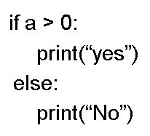
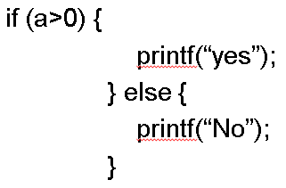
Language Semantics
Python: Indentation, not braces
C, C++, C#: Braces
Uses whitespace (tabs/spaces) to structure a code.
Example:
Colon (‘:’) – start of indented block;
same block = same indentation
Uses braces to structure a code.
Example:

Slide 8
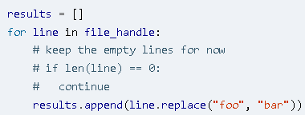
Language Semantics
Everything is an object
Includes numbers, strings, data structures, functions, classes, modules, etc.
Each object has an associated type and internal data.
Comments
Hash mark # is used to add comments to code.

Slide 9


Language Semantics
Function and object method calls
Use parenthesis ( ) to make function calls
Can pass no or more arguments to a function.
Can assign the returned value to a variable.
Methods – attached function to almost every object in Python that can access the contents in the object.
Syntax:
Takes positional(first 3 in the example) and keyword(last 2 in the example) arguments

Slide 10

Language Semantics
Variables and argument passing
We assign a variable in Python by referencing to the object on the righthand side of the equal sign.
Ex. a = [1, 2, 3] assigning a list of integers to the variable ‘a’
Assign variable ‘a’ to a new variable ‘b’.
In Python, b does not copy the data a, instead the variables a and b refer to the same object.

Slide 11

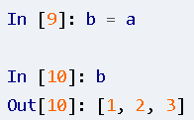
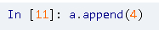



Language Semantics
Passing Variables and Arguments
Example:
Try & execute:
Output:
Dynamic references & Strong types
type() - finds the type of an object in Python.
Example:
Output:
Binding (or assignment)
b = [1, 2, 3, 4] because of binding; and b == a

Slide 12
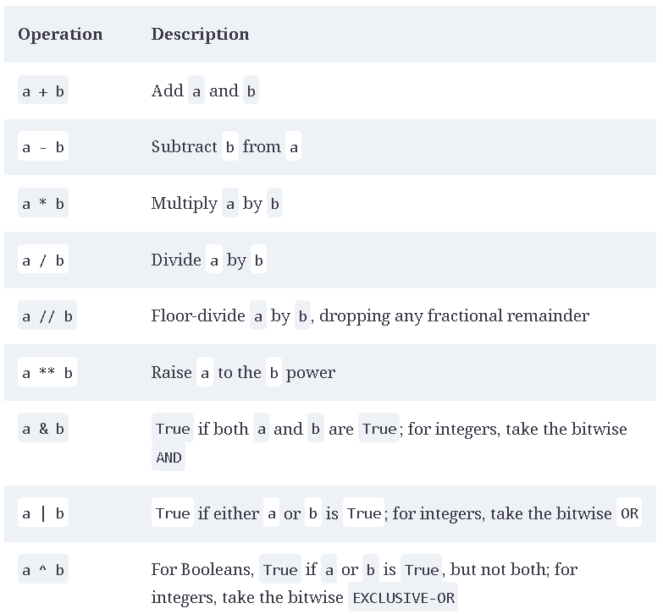
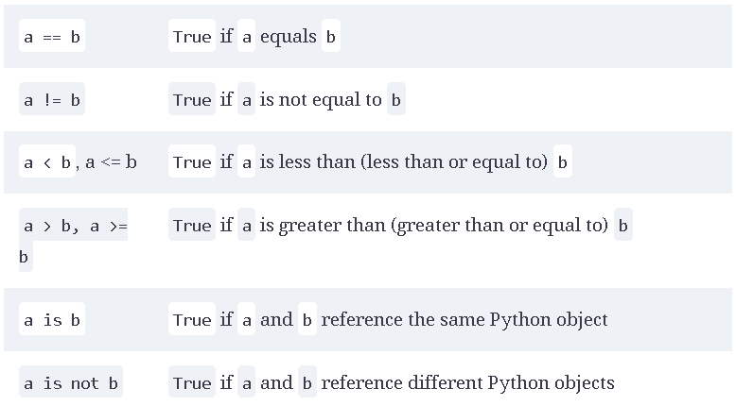
Language Semantics
Binary operators
Comparison operators
Most binary operations are similar to other languages.
Most comparison operations and are similar to other languages.

Slide 13
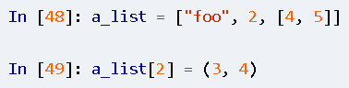



Language Semantics
Mutable and immutable objects
Mutable - values can be modified; most objects in Python are mutable.
Mutable: lists, dicts, NumPy arrays, and most user-defined types
Example:
Result: last item changed from[4,5] to (3, 4)
Immutable – values can’t be modified: strings and tuples
Example:
Try: TypeError because tuples are immutable.

Slide 14
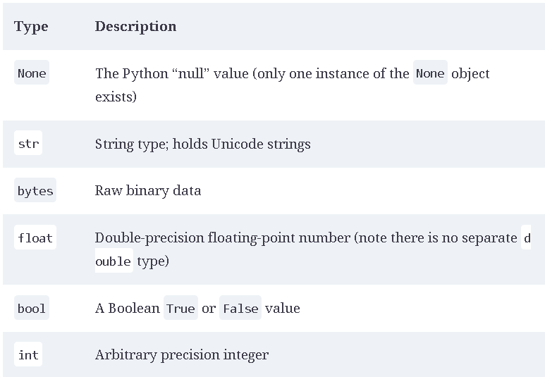
Scalar Types
Scalar - “single” value types
Python's built-in types for handling scalar types of data:
numerical data
strings
Boolean values
dates and time
Python Scalar Types:

Slide 15
Control flows
Python’s built-in keywords for conditional logic, loops and other standard control flow concepts:
if, else, and elif
for loops
while loops
pass
range
ternary expressions

Slide 16
Control flows
if, elif, and else
if statement checks a condition; if the condition is True, evaluates the code in the block that follows the condition.
if x < 0:
print(“It is negative.”)
if statement can be followed by one or more elif (else if) blocks or else blocks.
if x < 0:
print(“It is negative.”)
elif x == 0:
print(“Equal to zero.”)
else:
print(“It is positive.”)

Slide 17
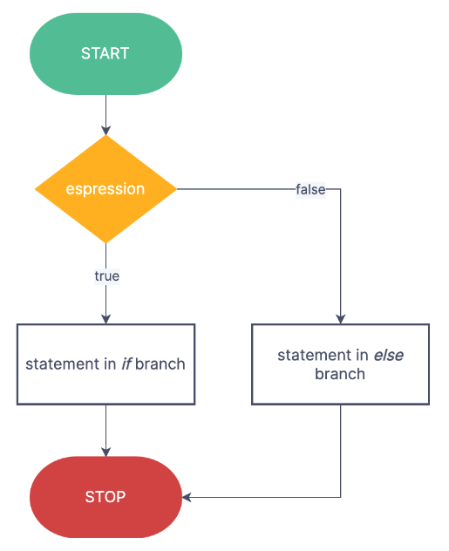
Control flows
if, elif, and else
Example 1:
a = 5; b = 7
c = 8; d = 4
if a < b or c > d:
print(‘Made it’)
In this example, ‘or’ is used so, c > d never gets evaluated as the first condition is True.
If ‘and’ is used both conditions: a < b and c > d gets evaluated.
prints the message only if both conditions are True.
Example 2: Chain comparisons
4 > 3 > 2 > 1
www.zenflowchart.com

Slide 18
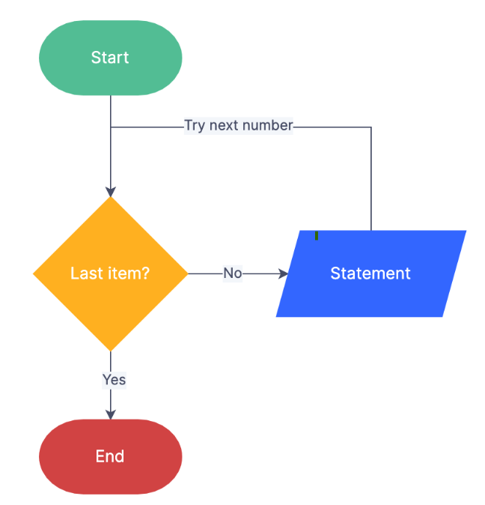
Control flows
for loops – iterators that allow code to be executed repeatedly over a collection: list/tuple
Syntax:
for value in collection:
# do something with value
Example 1:
my_list = [1, 2, 3, 4, 5]
total = 0
for value in my_list :
total += value
Example 2:
total = 0
for i in range(5): # range(5) output values 0-4
total += value
www.zenflowchart.com

Slide 19
Control flows
for loops
continue - keyword used to skip a certain iteration.
Example:
sequence = [1, 2, None, 4, None, 5]
total = 0
for value in sequence:
if value is None:
continue
total += value
for loops
break - keyword used to exit the innermost for loop.
Example:
sequence = [1, 2, 0, 4, 6, 5, 2, 1]
total_until_t = 0
for value in sequence:
if value == 5:
break
total_until_t += value

Slide 20
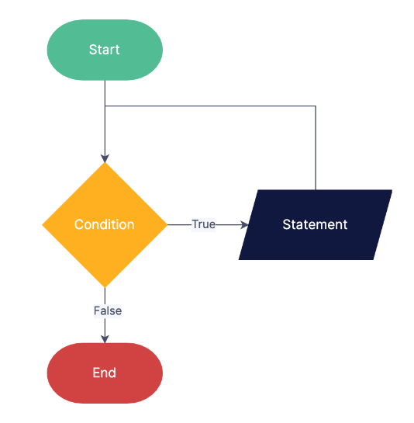
Control flows
while loops - start with a condition followed by a block of code.
Codes are executed until condition becomes False or ends with break.
Example
x = 256
total = 0
while x > 0:
if total > 500:
break
total += x
x = x //2
www.zenflowchart.com

Slide 21
Control flows
pass – keyword used as a placeholder when code is not yet implemented.
Example
if x < 0:
print(‘negative!’)
elif x == 0:
# TODO: put something smart here
pass
else:
print(‘positive!’)
www.zenflowchart.com

Slide 22
Control flows
range – generates an iterator that provides a sequence of integers; arguments: one, two, or three
Syntax: range(stop); range(start, stop); range(start, stop, step)
Examples:
range(10): generates an iterator of whole number from 0 to 9; 10 stop point (this is exclusive)
range(0, 10): same result as range(10); 0 start point, 10 stop point
range(0, 20, 3): generates an iterator 0, 3, 6, 9, 12, 15, 18; 0 start point, 10 stop point, 3 step size
range(5, 0, -1): generates an iterator 5, 4, 3, 2, 1
Common practice: range() is used with len() to iterate through elements in a list/tuple.
len() - returns the number of elements in a list/tuple.
Example: seq = [1, 2, 3, 5]
for i in range(len(seq)):
value = seq[i]**2

Slide 23
Control flows
Ternary expression – transforms simple if-else block into a single line or expression.
if-else block:
if condition:
value = true_expr
else:
value = false_expr
Example:
x = 5
'Non-negative' if x >= 0 else 'Negative'
Ternary expression - not recommended for complex if-else blocks
Equivalent ternary expression :
value = true_expr if condition else false_expr

Slide 24
References
references
McKinney, W. (2022). Python for Data Analysis: Data Wrangling with Pandas, Numpy, and IPython. O’Reilly. (ISBN: 1-0981-0402-1)
McKinney, W. (2022). Python for Data Analysis: Data Wrangling with Pandas, Numpy, and IPython. O’Reilly. (ISBN: 1-0981-0402-1)

Slide 25
Thank you!

